Slide 1
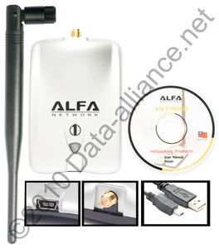
AWUS036H Driver Installation Guide

Slide 2
Insert CD
Go to My PC
Open ALFA Network

Slide 3
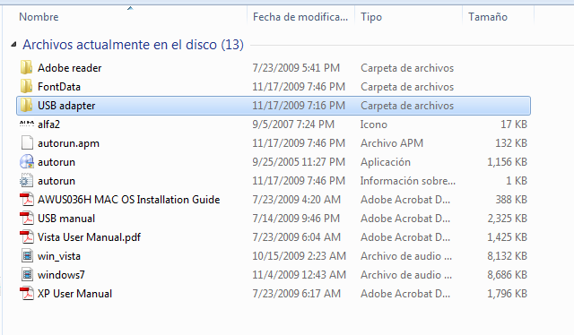
Open USB adapter file

Slide 4
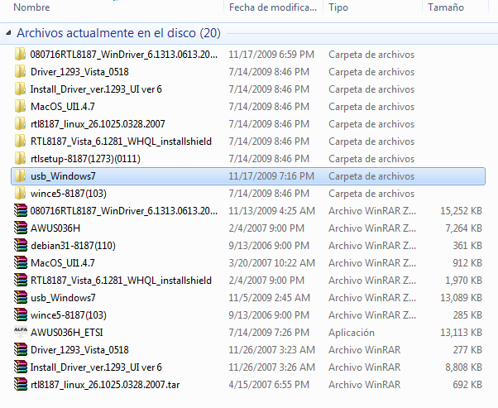
Open the corresponding folder for your Operating System
In this case usb_Windows7

Slide 5
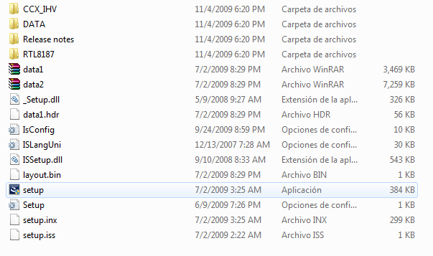
Open the File
Click on

Slide 6
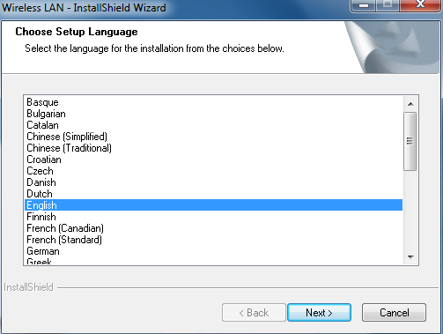
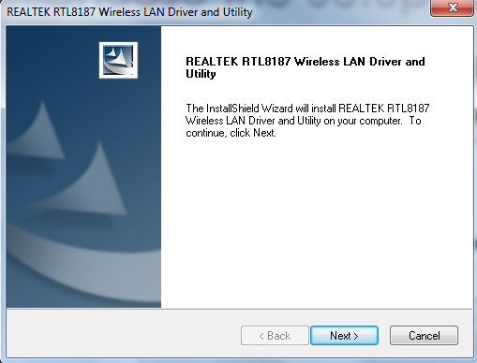
Choose the Setup Language
Click Next

Slide 7
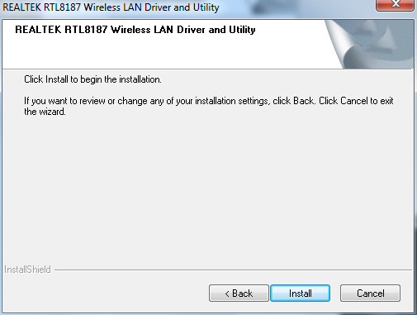
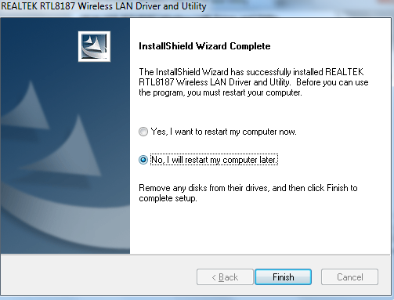
Click Install to begin installation
Select Yes, I want to restart my computer now; ClickFinish

Slide 8
Thank you very much for watching. Don’t forget to visit www.data-alliance.net Your source of Wi-Fi equipment

